Slide 1
AI-BASED MEHNDI DESIGN RECOMMENDATION SYSTEM
PRESENTED BY
SHAHANAMOL KN
ROLL NO:49
S4MCA
GUIDED BY,
MR.ELDHOSE K PAUL
ASSOCIATE PROFESSOR
DEPT.OF COMPUTER APLLICATIONS

Slide 2
Problem Identification
Lack of an intelligent and personalized system for recommending suitable mehndi designs based on individual hand structure
Limited access to automated, accurate, and data-driven mehndi design selection, leading to subjective and time-consuming decisions
Inadequate integration of mehndi design recommendation with artist booking and availability management
Difficulty in managing mehndi design selection, artist bookings, payments, and user preferences within a single unified platform

Slide 3
Problem Statement
Existing mehndi selection and booking systems rely heavily on manual browsing and subjective artist suggestions, lacking intelligent and personalized design recommendations
Limited use of automation and AI leads to time-consuming decision-making and difficulty in selecting suitable mehndi designs based on individual hand structure
Access to accurate, data-driven guidance for matching hand geometry with appropriate mehndi styles is often insufficient
Current solutions are inefficient in integrating AI-based design recommendation, artist availability, booking management, and secure payments within a single unified platform

Slide 4
Proposed System
Provides an AI-powered mehndi design recommendation platform for personalized and intelligent design selection
Analyzes uploaded plain hand images using computer vision to extract hand landmarks and geometric features
Uses AI-based matching algorithms to recommend suitable mehndi styles such as Arabic, Bridal, and Floral based on hand structure
Integrates design recommendation with artist booking, availability management, secure online payments, and centralized admin control in a single platform

Slide 5
Modules of the Proposed System
Admin
Manage users and artists
Approve mehndi designs
Approve henna products
Monitor AI recommendations
Set commission for product sales
View analytics, sales reports, and complaints

Slide 6
User Module
User registration and login
Upload plain hand image
View AI-recommended mehndi designs
Book mehndi artist
Purchase henna products (₹40 per cone or as listed)
Online payment for services and products
View booking and order history
Provide feedback and ratings

Slide 7
Artist Module
Artist registration and login
Upload mehndi designs
Tag designs (type, hand size, coverage)
View AI-based recommendations
Manage booking requests
Add henna products for sale (e.g., henna cone ₹40)
Manage product stock and pricing
View product orders
View total earnings (service + product sales)

Slide 8
Project Plan With Dates
Topic Finalization : 07 / 01 / 2026
Problem Identification & Problem Statement : 08 / 01 / 2026 – 09 / 01 / 2026
Requirement Analysis & Literature Survey : 10 / 01 / 2026 – 12 / 01 / 2026
System Design (Modules & Architecture) : 13 / 01 / 2026 – 15 / 01 / 2026
Tools & Technology Selection : 16 / 01 / 2026 – 17 / 01 / 2026
Implementation Phase : 18 / 01 / 2026 – 20 / 02 / 2026
Testing & Validation : 21 / 02 / 2026 – 25 / 02 / 2026
Documentation & PPT Preparation : 26 / 02 / 2026 – 28 / 02 / 2026
Final Review & Submission : 01 / 03 / 2026 – 03 / 03 / 2026

Slide 9
Tools and Technology
Python – Core programming language used for AI logic, image processing, and backend development
Artificial Intelligence & Machine Learning – Used for analyzing hand structure and generating personalized mehndi design recommendations
Computer Vision Techniques – Applied for hand image preprocessing, landmark detection, and geometric feature extraction
Hand Landmark Detection Models – Identify fingertips, joints, palm width, and finger length from uploaded hand images
HTML & CSS – Used for designing responsive web interfaces for user, artist, and admin modules
JavaScript – Enables dynamic interactions and client-side validations in the web application
Django Framework – Backend framework for handling business logic, authentication, and system integration
MySQL / SQLite – Database for storing user details, mehndi designs, bookings, payments, and feedback
Online Payment Gateway – Facilitates secure digital payments for bookings and henna product purchases
PyCharm / VS Code – Development environments used for coding, debugging, and testing the application

Slide 10
Diagrams

Slide 11
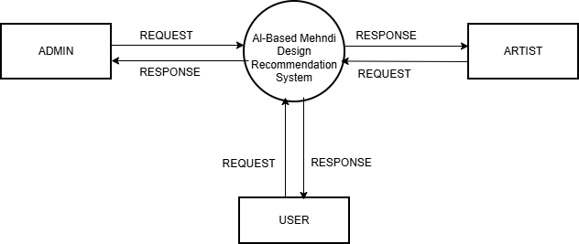
Level 0 DFD

Slide 12
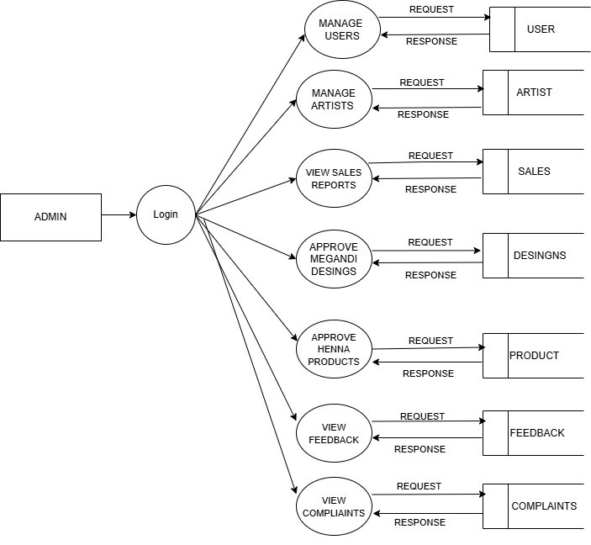
Level 1 DFD

Slide 13
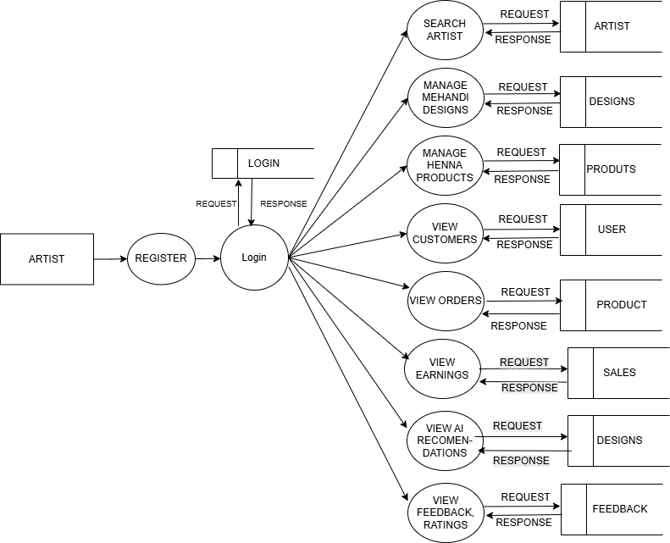
Level 2 DFD

Slide 14

Level 3 DFD

Slide 15
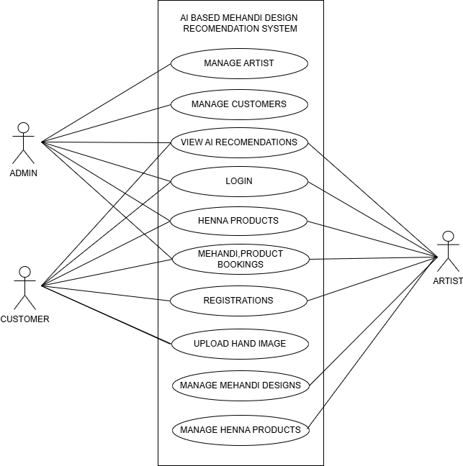
Usecase_diagram

Slide 16
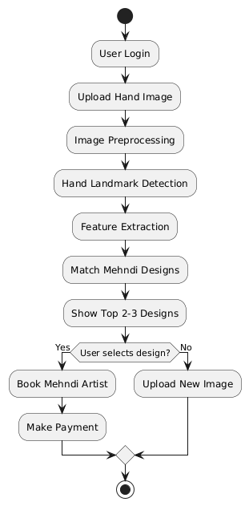
Activity_diagram

Slide 17
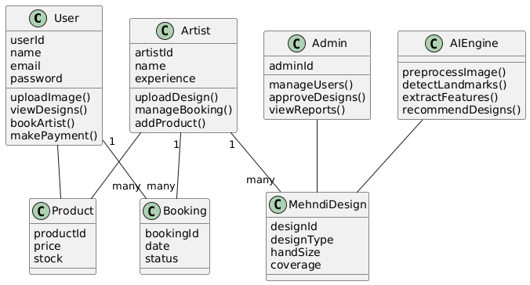
class_diagram

Slide 18
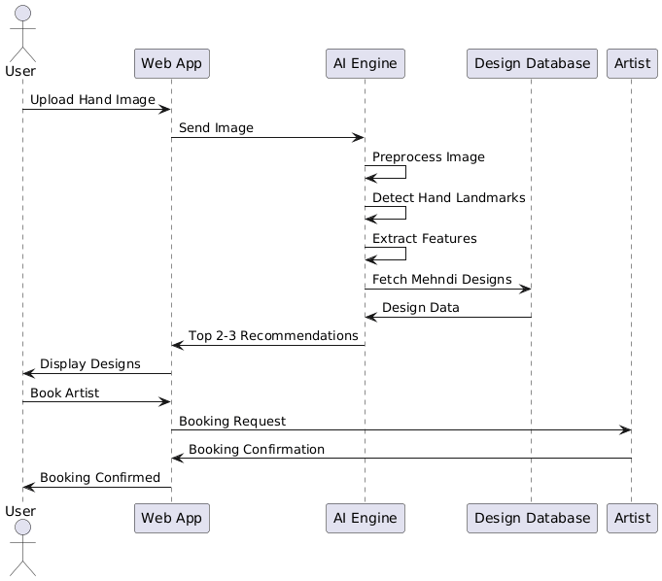
Sequence_diagram

Slide 19
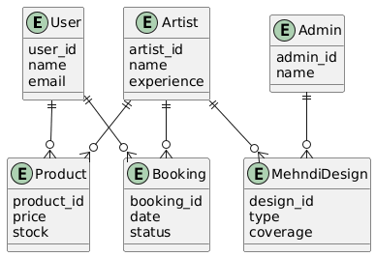
ER_diagram

Slide 20
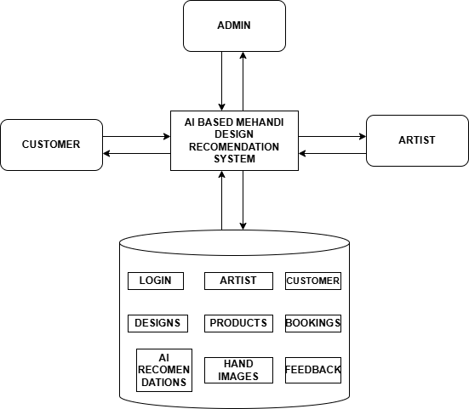
System_Architecture

Slide 21
THANK YOU

